Slide 1
Quick Commerce Order And Delivery Performance Analysis
Presented BY
Harini Selvaraj

Slide 2
Introduction
Quick commerce platforms generate large volumes of operational and customer data every day across different cities and companies. Analysing this data helps understand delivery performance, customer ratings, order trends, discount usage and regional business performance.
Power BI is a business intelligence and data visualization tool that converts raw quick commerce data into interactive dashboards and reports. It helps users easily explore data, identify patterns and gain meaningful insights for better decisions.
A Power BI dashboard simplifies quick commerce operations analysis and provides clear, actionable insights to improve delivery efficiency and business performance.

Slide 3
Problem Statement
Quick commerce operational data is large and complex, making it difficult to analyze delivery performance, customer ratings, order trends and discount impact using traditional methods.
Without proper visualization and analysis, it becomes challenging to monitor on-time delivery, compare company performance, evaluate category contribution and understand city-wise business performance for effective operational planning.
This project aims to address this problem by developing a Quick Commerce Operations Dashboard using Power BI, which converts raw operational data into interactive and insightful visualizations to support efficient analysis and data-driven decision making.

Slide 4
Business Problems
Which quick commerce companies are achieving the highest on-time delivery performance, and which platforms are operationally more efficient?
How is our overall order volume and operational performance trending over time, and are there any identifiable peak periods or demand patterns?
How does delivery time influence customer ratings across different companies and cities?
Which product categories are contributing the highest order value, and which categories are top performing for each company?
How does order value and performance vary across different cities, and which cities present opportunities for business growth?
What is the distribution of orders across cities, and how can this information help improve delivery planning and logistics operations?
How does discount usage influence order value and customer behaviour, and does offering discounts improve business performance?

Slide 5
Data Overview
Total Records: 100000+ orders
Data Fields:
Order ID
Company Name (Blinkit, Zepto, Swiggy Instamart, Big Basket, Amazon Now, Dunzo,
Flipkart Minutes, Jio Mart)
Product Category
City
Delivery Time (Minutes)
Customer Rating
Order Value
Discount Applied
Distance
Items per Order
Payment Method

Slide 6
Technology Used
Data Source: Quick Commerce Operations Dataset (Excel file)
Data Preparation & Transformation (ETL): Power Query – to clean, transform and prepare the data for analysis
Data Modeling: Created tables such as Company, City, Product Category and Payment Method Established proper relationships between tables
Data Analysis & Visualization: Power BI Charts used: Column chart, Scatter chart, Donut chart, Treemap, Waterfall chart and Map visual Measures created using DAX
Data Insights & Reporting: Power BI Dashboard – interactive dashboard for operational and business analysis Filters & Slicers – to analyse data by company, city, category, discount status and payment method

Slide 7
Dax Measures
DAX is called as Data Analysis Expressions. DAX is a formula language used in Power BI to perform calculations and data analysis.
Measures:
Total Orders
On-Time delivery%
Total Order Value Average Delivery Time Average Customer Rating

Slide 8
Data Preprocessing
The Best Tool For Cleaning And Pre-processing is Power Query Editor.
It Is Used For Extracting The Data, Transforming The Data And Loading Into Power BI.
Data Cleaning steps :
Changing the data type of discount-applied from 0,1 to Yes and No.
Change datatype of Rating from decimal to whole number.
Segregate city column to create separate table and create index for city id.
Segregate the product column and product ID and creating a separate table.
Segregate the payment method column and paymentID for creating a payment table.
Removing the duplicate values.

Slide 9
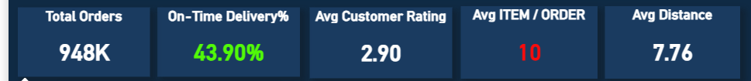
Key Metrics and KPIs’
These KPIs give a quick snapshot of business performance
Total Revenue: It refers to the overall revenue generated from all completed transactions during a specific period of time.
Total Orders: It tells you how many orders were made within the period.
On-time Delivery%: It refers to the sum of all product units sold during a specific period.

Slide 10
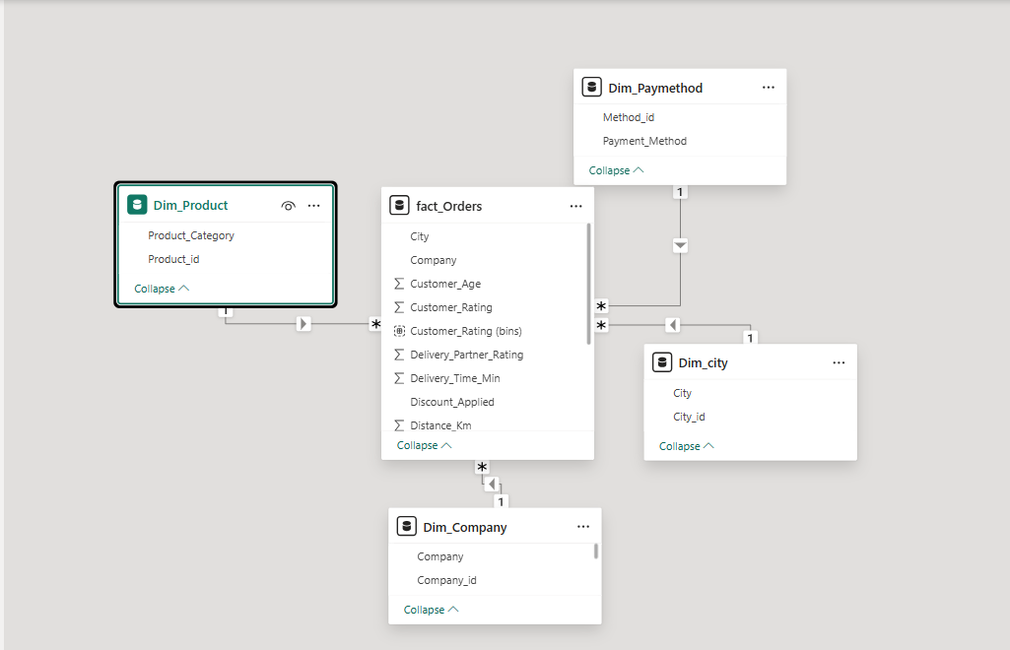
Data Modeling Overview

Slide 11
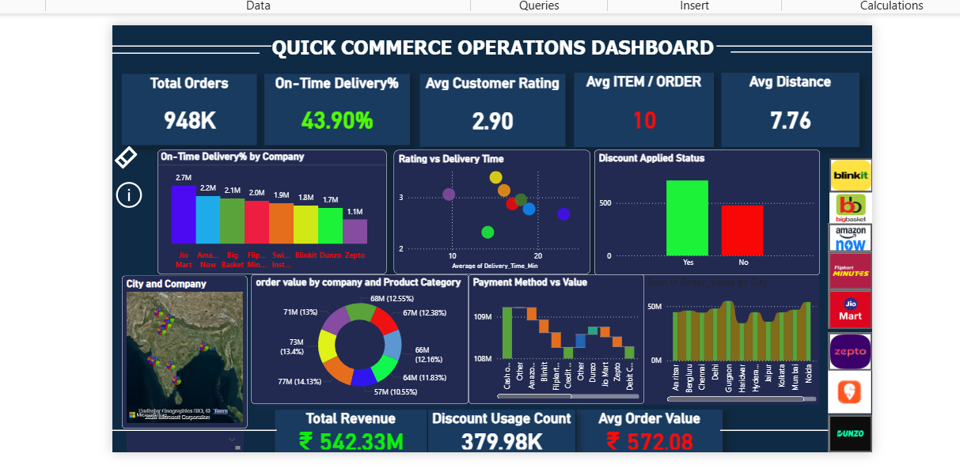
Power BI Dashboard Overview

Slide 12
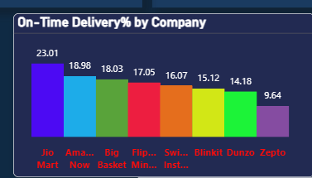
On-Time Delivery % by Company
Column Chart: It clearly shows and compares the on-time delivery performance of each quick commerce company and helps identify the most operationally efficient platforms.
X-axis: Company Name (Blinkit, Zepto, Swiggy Instamart, Big Basket, Amazon Now, Dunzo, Flipkart Minutes, Jio Mart)
Y-axis: Average Deliver Time

Slide 13
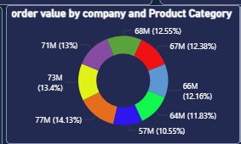
Order Value by Product Category
Donut Chart: It Shows Percentage Contribution of Order Value by each company .
Legend: Company Name (Blinkit, Zepto, Swiggy Instamart, Big Basket, Amazon Now, Dunzo, Flipkart Minutes, Jio Mart)
Product Category
Value: Order Value

Slide 14
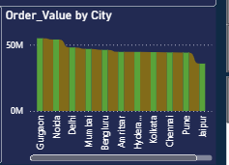
Order Value by City
Ribbon Chart: It Shows Percentage Contribution of Order Value by each city.
X-axis: City name (Noida, Amritsar, Mumbai, Delhi, Kolkata, Bengluru, Chennai, Hyderabad, Pune, Haridwar, Jaipur, Gurgaon)
Y-axis: Order Value

Slide 15
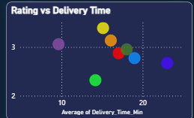
Impact of Delivery Time in Ratings
Sactter Chart: It Shows Impact of Delivery time in Customer Ratings.
X-axis: Delivery Time
Y-axis: Customer Rating

Slide 16
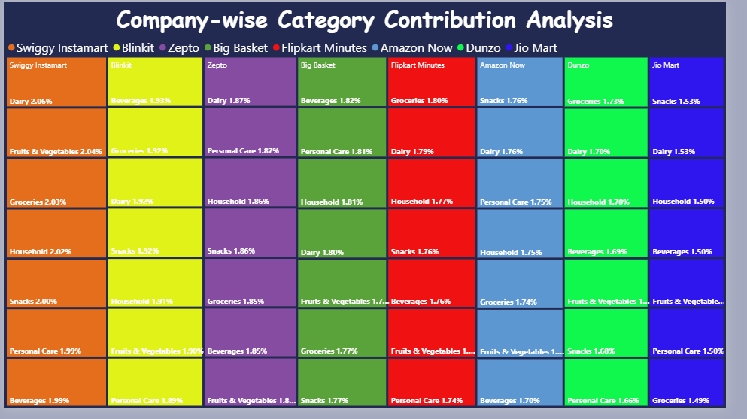
Company Wise Product Contribution Analysis
Treemap: It Shows Percentage Contribution of Order Value by each products in each company.
Category: Comapny
Details : product category
Value: Order Value

Slide 17
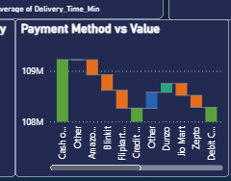
Total Value by Payment method by company
Waterfall Chart: It clearly shows how each payment method and company contributes to the overall order value and helps compare positive and negative changes across companies.
Category: Payment Method and Company
Breakdown: Company
Y-axis: Order Value (Amount)

Slide 18

Interactivity and Navigation
In this dashboard, each company is represented using its official icon instead of a normal slicer.
When the user clicks a company icon, the related charts and KPIs automatically change to show only that company’s data.
This interaction is implemented using Bookmarks in Power BI.
Each bookmark stores a specific visual state for a selected company.
Buttons are linked to the respective bookmarks to enable smooth navigation.
This approach improves user experience and makes the dashboard more interactive and visually intuitive.
It also allows quick comparison of performance across different companies.

Slide 19

Page Navigation
In this dashboard, a Clear Slicer icon is provided to reset all slicer selections at once.
When the user clicks the Clear icon, all applied filters and slicers are automatically cleared using a bookmark action.
This helps users quickly return to the default dashboard view.
An Information icon is also added in the dashboard for user guidance. When the user clicks the Information icon, it navigates to an external web page.
This feature is implemented using buttons and action (web URL navigation) in Power BI.
It improves usability and helps users easily understand the dashboard.

Slide 20
Thank you!!!

